Slide 1
DATA ANALYTICS PROJECT
E-COMMERCE SALES &
CUSTOMER ANALYTICS
A Data-Driven Business Analysis Using SQL, Power BI & Excel
PREPARED BY MOHAMMED RINSHID K
TOOLS Excel | Power Query | MySQL / SQL | Power BI
August 2026

Slide 2
INTRODUCTION
EANALYTICS
Project Overview
OBJECTIVE
ANALYTICS WORKFLOW
To analyze e-commerce sales, profitability, customer and operational performance using data analytics techniques.
1
Raw Data
WHAT WAS ANALYZED
Sales and revenue performance
2
Data Cleaning (Power Query)
Product and category performance
3
SQL Analysis (MySQL)
Regional performance
Customer contribution
4
KPI Development
Profitability
Returns and cancellations
5
Power BI Dashboards
6
Business Insights
02

Slide 3
FRAMING
EC-ANALYTICS
Business Problem & Objectives
BUSINESS PROBLEM
The business needed better visibility into sales performance, profitability, customer contribution and operational issues.
KEY BUSINESS QUESTIONS
PROJECT OBJECTIVES
What are the overall sales and profit?
Clean and prepare the data
Which products and categories perform best?
Build a structured data model
Which regions generate the highest sales and profit?
Perform SQL analysis
Which customers contribute most to revenue?
Develop business KPIs
What are the major return and cancellation risks?
Create interactive Power BI dashboards
What actions can improve business performance?
Identify actionable business insights
03

Slide 4
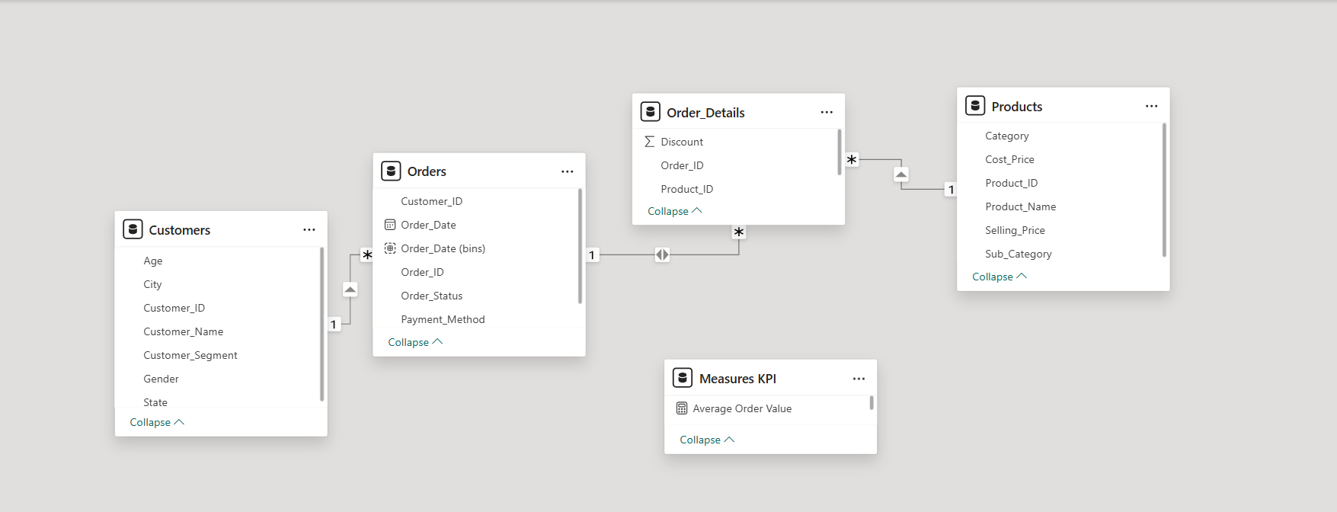
DATA FOUNDATION
Dataset & Data Model
DATASET
Four interconnected e-commerce tables:
POWER BI DATA MODEL
Table | Purpose
Customers | Customer information
Products | Product & pricing info
Orders | Order-level information
Order Details | Product-level transactions
KEY RELATIONSHIPS
Customers → Orders (Customer_ID)
Orders → Order Details (Order_ID)
Products → Order Details (Product_ID)
Star-schema model built in Power BI, linking Customers, Orders, Order Details and Products through shared keys, with a dedicated Measures KPI table for DAX calculations.
04

Slide 5
METHODOLOGY
EC-ANALYTICS
Data Preparation & SQL Analysis
✓
Data Cleaning (Power Query)
</>
SQL Analysis (MySQL)
Removed unnecessary spaces
MySQL / SQL was used to analyze:
Standardized text values
Sales
Products
Corrected data types
Customers
Regions
Handled missing values
Profitability
Payment methods
Standardized dates
Checked duplicate records
Order status
Returns and cancellations
Validated numerical fields
05

Slide 6
PERFORMANCE SNAPSHOT
EC-ANALYTICS
Key Performance Indicators
5.82M
1.35M
23%
TOTAL SALES
TOTAL PROFIT
PROFIT MARGIN
80
80
341
TOTAL ORDERS
TOTAL CUSTOMERS
QUANTITY SOLD
72.69K
21%
10%
AVG ORDER VALUE
RETURN RATE
CANCELLATION RATE
06

Slide 7
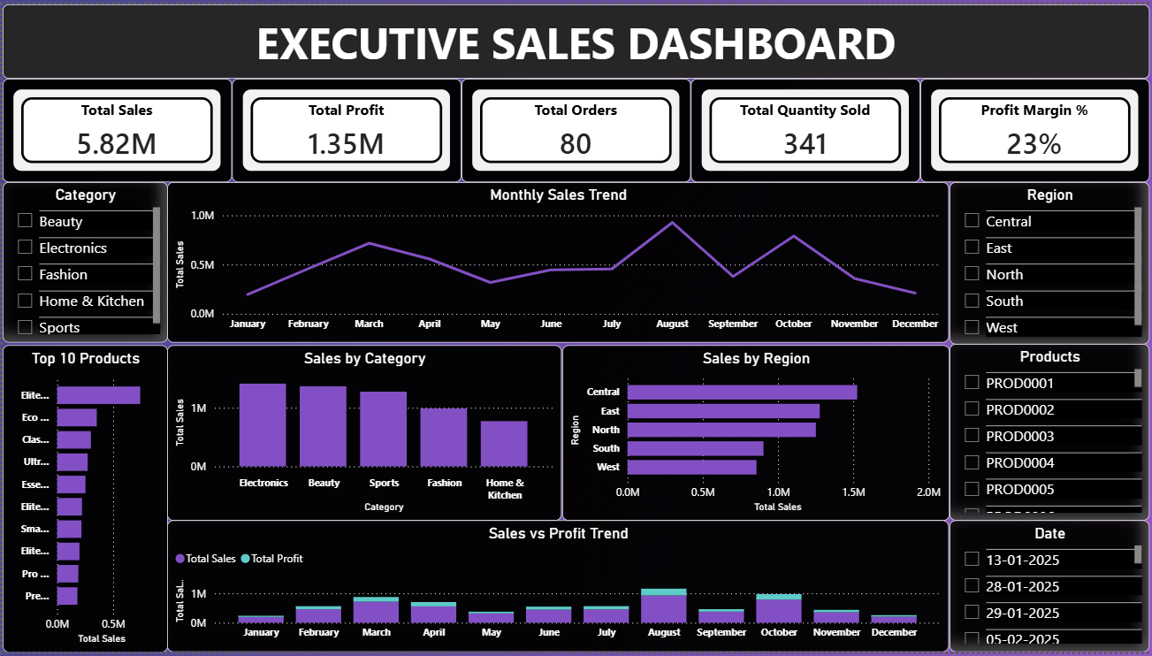
DASHBOARD 01
Executive Sales Dashboard
Executive-level view of overall sales performance — revenue, monthly trend, category, region, top products, order status.
07

Slide 8
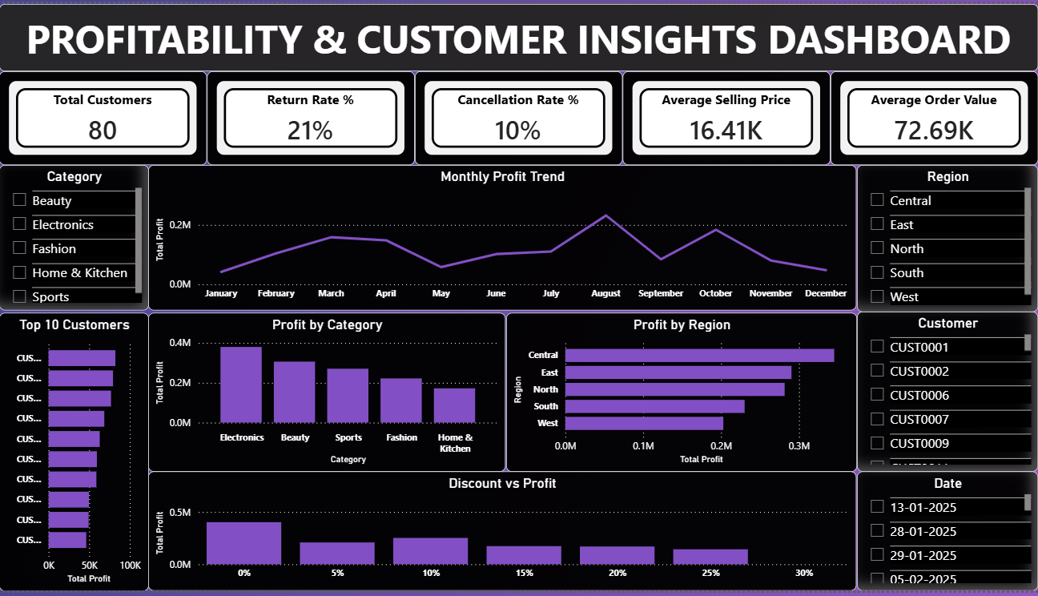
DASHBOARD 02
Profitability & Customer Insights
Deeper analysis of profitability, customer contribution and regional performance.
08

Slide 9
FINDINGS
EC-ANALYTICS
Key Business Insights
Sales Performance
Profitability
Customer & Operations
Total sales reached 5.82M
Electronics generated the highest profit
Average Order Value was 72.69K
Electronics generated the highest sales
Central generated the highest profit
Return Rate was 21%
Central recorded the highest sales
Sales and profit followed a similar monthly pattern
Cancellation Rate was 10%
August recorded the highest monthly sales
Profit contribution varied across categories
09

Slide 10
DEEP DIVE
Root Cause Analysis
ELECTRONICS — HIGHEST SALES
CENTRAL — HIGHEST SALES
AUGUST — HIGHEST SALES
Elite Audio Pack 14
Eco Outdoor Set 72
Elite Equipment Set 80
Sales: 741,104.32
Sales: 176,761.80
Sales: 197,274.32
Quantity: 22 units
Quantity: 6 units
Quantity: 8 units
Major contribution from East
CUST0013 purchased all 6 units
All 8 units sold in South
CUST0017 purchased all 8 East units
CUST0057 purchased all 8 units
ROOT CAUSE
ROOT CAUSE
ROOT CAUSE
Strong sales volume and high selling price concentrated around a key Electronics product.
Central sales were significantly supported by a high-performing product and concentrated customer demand.
August's peak was strongly influenced by a high-value product transaction.
10

Slide 11
ACTION PLAN
EC-
Business Recommendations
1
Strengthen High-Performing Electronics Products
5
Diversify High-Profit Customer Contributions
Maintain availability and analyze successful pricing and demand characteristics.
Reduce dependence on individual high-value customers.
2
Reduce Customer Concentration in Central
6
Investigate High Returns in West
Expand the customer base and target similar customer segments.
Analyze product, delivery, fulfillment and customer-expectation issues.
3
Replicate August Sales Patterns
7
Reduce Cancellations in Central
Identify the products, regions and demand factors behind the August peak.
Review payment processing, stock availability, order confirmation and fulfillment.
4
Focus on High-Profit Products
Prioritize products such as Elite Audio Pack 14 and monitor their margins.
11

Slide 12
CLOSING
Conclusion
This project transformed raw e-commerce data into actionable business insights using Excel, Power Query, SQL and Power BI.
KEY TAKEAWAYS
Identified major sales and profit drivers
Evaluated product and regional performance
Analyzed customer contribution
Identified return and cancellation risks
Developed data-driven business recommendations
“Data-driven analysis can help businesses understand performance, identify opportunities and make better decisions.”
12

